Slide 1
Introduction to Bankruptcy Law and the Bankruptcy System: An Educational Primer for State Courts [Template Presentation For Educational Use]
This template presentation, provided by the Federal Judicial Center, combines, edits, and expands presentations given by bankruptcy judges and state trial court judges. Contact Jason A. Cantone, at fedstate@fjc.gov, for more information.
Notes:
This presentation was greatly benefitted by the following individuals, who reviewed an earlier draft of the presentation: Hon. Shon Hastings, Hon. Craig Whitley, Hon. Cate Furay, Hon. Charles L. Nail, Jr., Hon. Ashely Chan, Hon. Robert Kressel, Hon. Robert Drain, Hon. Diane Finkle, Hon. Robert Faris, Elizabeth Wiggins, and Brian Lynch. The presentation utilizes and expands on prior educational materials provided alongside interviews held by Dr. Jason Cantone with: Hon. Dan Collins, Hon. Brian Davis, Hon. Robert Faris, Hon. Cate Furay, Hon. Martin Glenn, Hon. A. Benjamin Goldgar, Hon. Mary Gorman, Hon. Laurel Isicoff, Hon. Catherine McEwen, Hon. Robyn Moberly, Hon. Mindy Mora, Hon. Chris Panos, Hon. Laura Taylor, and Ann M. Anderson. This presentation was made better by all of these individuals, as well as the Judicial Conference Committee on Federal-State Jurisdiction.

Slide 2
Content Note
This presentation only addresses the automatic stay. A full presentation with all six topics (bankruptcy overview; automatic stay; bankruptcy discharge; family law; foreclosure; additional considerations) is available at fjc.gov/fedstate, as well as separate presentations for each of those topics.
Notes:
If you would like a Powerpoint that includes the full presentation or the topics provided in the note, please visit fjc.gov/fedstate.

Slide 3
The Automatic Stay

Slide 4
The Automatic Stay
Bankruptcy Code 11 U.S.C. §362
(a) Bankruptcy operates as a stay, applicable to all entities, of
the commencement or continuation, including the issuance or employment of process, of a judicial, administrative, or other action or proceeding against the debtor
the enforcement, against the debtor or against property of the estate, of a judgment obtained before the commencement of the case under this title
any act to obtain possession of property of the estate or of property from the estate or to exercise control over property of the estate
any act to create, perfect, or enforce any lien against property of the estate
any act to create, perfect, or enforce against property of the debtor any lien to the extent that such lien secures a claim that arose before the commencement of the case under this title
any act to collect, assess, or recover a claim that arose before the commencement of the case under this title
the setoff of any debt owing to the debtor that arose before the commencement of the case under this title against any claim against the debtor

Slide 5
The Automatic Stay
The filing of a bankruptcy petition triggers the automatic stay (a federal, statutory injunction). The stay
prevents estate property from being dismantled piecemeal by the debtor’s creditors
bars continued collection efforts against the debtor, property of the debtor, and property of the bankruptcy estate
bars continuation of most litigation against the debtor
The stay only affects claims and acts against the debtor, estate, or their property. It does not apply to claims by any of them against others.
Counterclaims against the debtor are stayed.

Slide 6
The automatic stay protects the estate, the debtor, and their property.
It does not protect:
(a) cosigners or guarantors
(b) accommodation mortgagors
(c) codefendants, joint tortfeasors, etc.
(d) a corporation, if only the shareholder files a petition
(e) the shareholders, if only the corporation files a petition
But there are exceptions!
The Automatic Stay

Slide 7
The Automatic Stay: Deadlines
The automatic stay applies throughout litigation, including appeals.
If there is a statute of limitations or other deadline to commence or continue a civil action, other than in bankruptcy court, and the action is stayed against the debtor (or, if applicable, a co-debtor), then:
the period is tolled until the later of the actual deadline or 30 days after notice of the termination or expiration of the stay.

Slide 8
The Automatic Stay: Exceptions
Common Exceptions in State Court:
criminal actions
paternity, setting or changing domestic support obligations, child custody, visitation, and dissolution of marriage
domestic violence actions
collection of support obligations–from property that is not property of the estate
More Exceptions:
evictions in nonresidential real property when the lease term has expired
tax audits, deficiency notices, assessments
HUD foreclosures on property with five or more units
police or regulatory enforcement actions brought by a governmental unit (e.g., consumer protection or environmental actions)

Slide 9
The Automatic Stay: Termination
The automatic stay terminates:
when the bankruptcy court so orders
as to property of the estate, when the property leaves the estate (e.g., upon abandonment)
as to all other acts, upon the earliest of the:
closing of the bankruptcy case
dismissal of the bankruptcy case
grant or denial of the debtor’s discharge

Slide 10
The Automatic Stay: Termination
If the bankruptcy is a Chapter 7 and a prior bankruptcy was dismissed within one year before the current filing, the automatic stay may terminate 30 days after the filing unless the debtor moves for a continuation of the stay.
The termination is as to the debtor.
However …

Slide 11
The Automatic Stay: Termination
Some bankruptcy courts interpret the provision to keep the stay in place as to the property of the estate.
Advice: State court judges are cautioned: do not assume that the stay is no longer in place for all of the debtor’s property (as opposed to property that is not estate property), and seek clarification if necessary.

Slide 12
The Automatic Stay: Termination
If there were two or more cases pending but dismissed within the prior year, the automatic stay does not go into effect.
Debtor can file a motion seeking to have a stay imposed.
If the case is a joint case but only one of the debtors was a debtor in the prior cases, then there is still a stay for the other debtor. This can create interesting issues in community property states such as Wisconsin.

Slide 13
The Automatic Stay: Termination
Caution: The law regarding to what extent the automatic stay terminates after 30 days for an individual who files a case within a year of the existence of a prior case is controversial.
See Rose v. Select Portfolio Servicing Inc., 945 F.3d 226 (5th Cir. 2019); contra In re Smith, 910 F.3d 576 (1st Cir. 2018).

Slide 14
The Automatic Stay: Codebtor Stay
A Chapter 12 or 13 filing also triggers a codebtor stay.
This protection reaches, for example, parents who have cosigned a note for their children and nonfiling spouses who are obligated with the debtor on a mortgage or car note.
The codebtor stay does not apply to professional sureties.
Only applies to CONSUMER debts.

Slide 15
Can a state court judge violate the automatic stay?
Answer: Yes!
While more often it is the lawyer or a party who violates the stay, it is still possible for a judge to do so.
Examples:
Conducting a pretrial conference or other hearing in a case if you have notice of a filed bankruptcy case.
This might occur in foreclosures, contract disputes, and personal injury actions as a few examples.
Granting a divorce does not violate the stay, but ordering or approving a property division may violate the stay unless the bankruptcy court has granted relief from stay.
Proceeding with a trial and apportioning liability to a debtor who was a joint tortfeasor.

Slide 16
Violating the Automatic Stay
Actions taken in violation of the automatic stay are void or voidable.
There is a split of authority on the distinction.
Creditors may have a duty to dismiss cases, not just hold them in abeyance.
Sanctions are available, such as actual damages, attorneys’ fees and costs, and punitive damages.

Slide 17
The Role of the State Court Judge
If the state court judge is in doubt about the stay or effect of a bankruptcy court order, what are some appropriate options?
suspend proceedings and direct parties to address issue
special docket
proceed against nondebtors
continue for status conference (to specifically address stay)

Slide 18
Violating the Automatic Stay
Advice: Ask yourself whether the action might advance a claim against the debtor or property of the estate.
What could happen next?
You could be sued for the violation of the stay.
The debtor might ask for damages.
Court action(s) would likely be void ab initio.
As stated by one bankruptcy judge:
“We may set aside an order in violation of the stay, but I’m unaware of any bankruptcy judge ever sanctioning a state judge for violating the stay. We’d go very slowly with that remedy.”

Slide 19
Relief from the Automatic Stay
A party in interest may obtain relief from the automatic stay by filing a motion with the bankruptcy court.
Relief may include:
Authorizing pursuit of in rem relief.
Permitting a matter to be tried and decided by a state court, but prohibiting the entry of any money judgment.
For cause, the bankruptcy court may terminate, annul, modify, or condition the stay.
The stay may be lifted by the bankruptcy court as to collection solely as to any available insurance.

Slide 20
Jurisdiction and the Automatic Stay
Bankruptcy and nonbankruptcy courts share concurrent jurisdiction to determine whether the automatic stay applies to a given action or proceeding.
Caution: In many circuits, if a bankruptcy court later disagrees with the determination that the stay does not apply, the bankruptcy court may declare the state court order void because it violated the stay.
Only the bankruptcy court can grant relief from the automatic stay.

Slide 21
Automatic Stay in Criminal Actions 11 U.S.C. § 362(b)(1)
The automatic stay does not operate to stay
“the commencement or continuation of a criminal action or proceeding against the debtor.”

Slide 22
Automatic Stay in Police and Regulatory Actions 11 U.S.C. § 362(b)(4)
The automatic stay does not operate to stay “the commencement or continuation of an action or proceeding by a governmental unit … to enforce [a] … police and regulatory power, including the enforcement of a judgment other than a money judgment” obtained in such a proceeding.
Caution: Whether a matter falls within the police or regulatory exception is often complex, and seeking clarification from the bankruptcy court is recommended.

Slide 23
Automatic Stay and Tolling 11 U.S.C. §108
Claims by the debtor/trustee:
If the time did not expire prior to bankruptcy, the debtor/trustee has until the later of the statutory deadlines or two years from when the bankruptcy was filed.
Debtor deadline to perform certain obligations:
If the deadline did not expire prior to bankruptcy, the debtor/trustee has until the later of the actual deadline or 60 days from when the bankruptcy was filed.

Slide 24
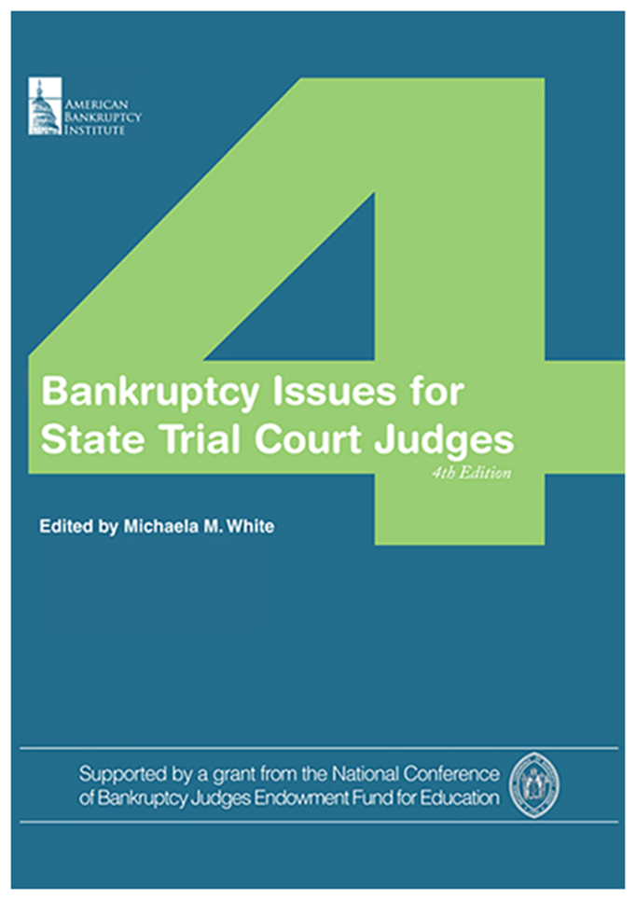
Additional Resources
Federal Judicial Center website on federal-state cooperation: https://fjc.gov/fedstate
National Center for State Courts resource guide on foreclosures: https://www.ncsc.org/Topics/Financial/Foreclosures/Resource-Guide.aspx

Slide 25
Thank You
This presentation was organized by Federal Judicial Center Senior Research Associate Jason A. Cantone, with considerable assistance by a number of federal and state judges and court personnel (see note for slide 1).
Questions about the presentation and its use can be directed to Dr. Cantone, at fedstate@fjc.gov. We would also like to hear from you if you find it helpful or have any recommendations to improve it.

